Slide 1
Individual Project 1
Brett Tully

Slide 2

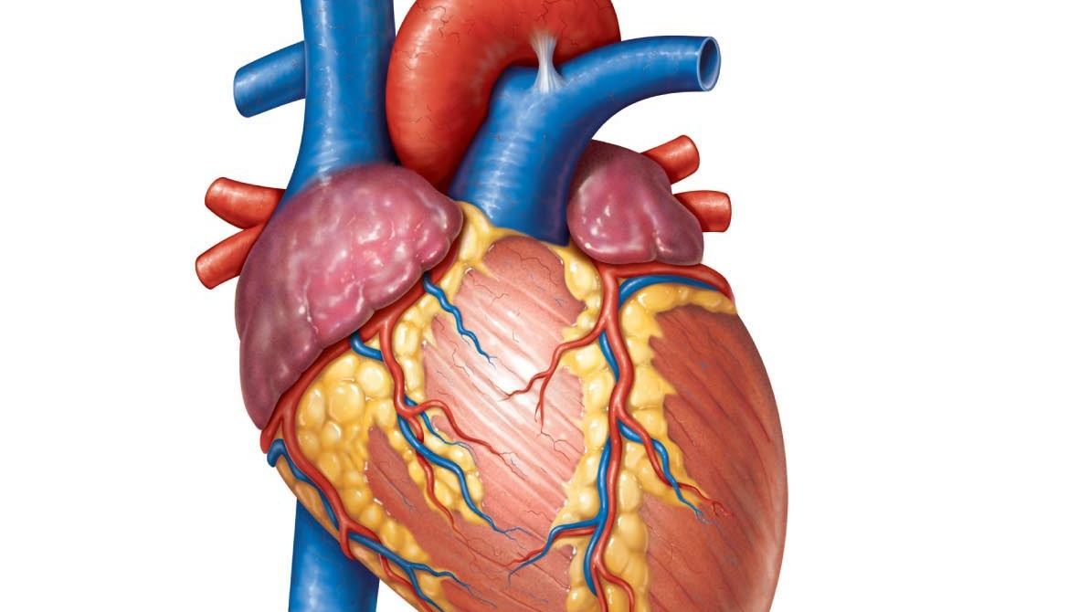
Dataset
Heart Disease Death prediction
13 columns
299 rows
0 Null values
This Photo by Unknown Author is licensed under CC BY-NC-ND

Slide 3
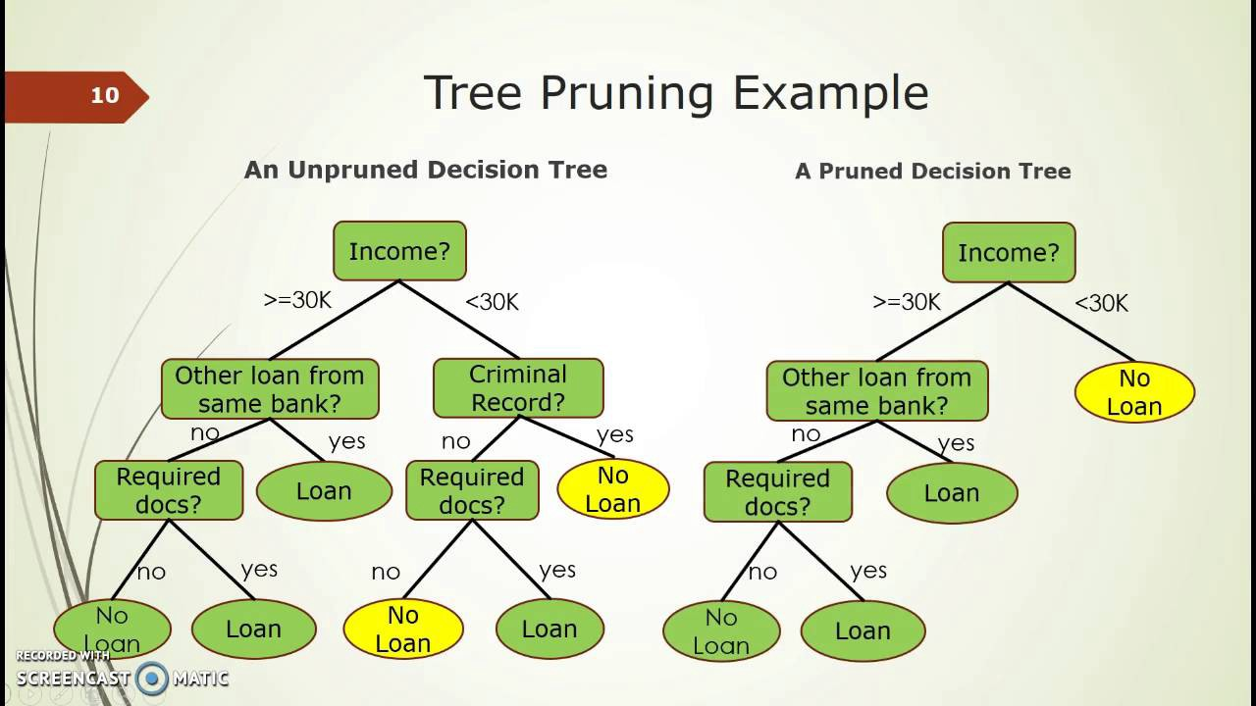
Models
Voting Classifier
Logistic Regression
Random Forest Classifier
Support Vector Classifier
Decision Tree Classifier
Bagging Classifier
Gradient Boosting Classifier
Ada Boosting Classifier.

Slide 4


Slide 5
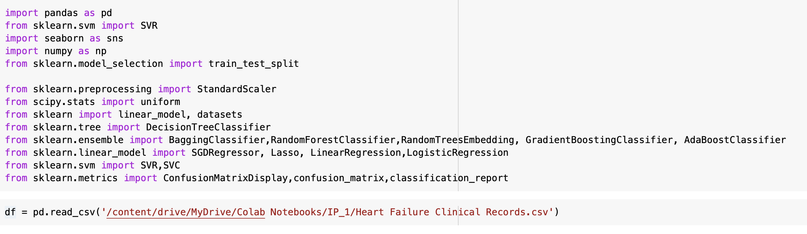

Slide 6
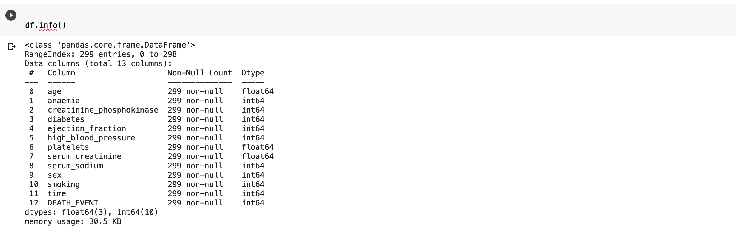

Slide 7
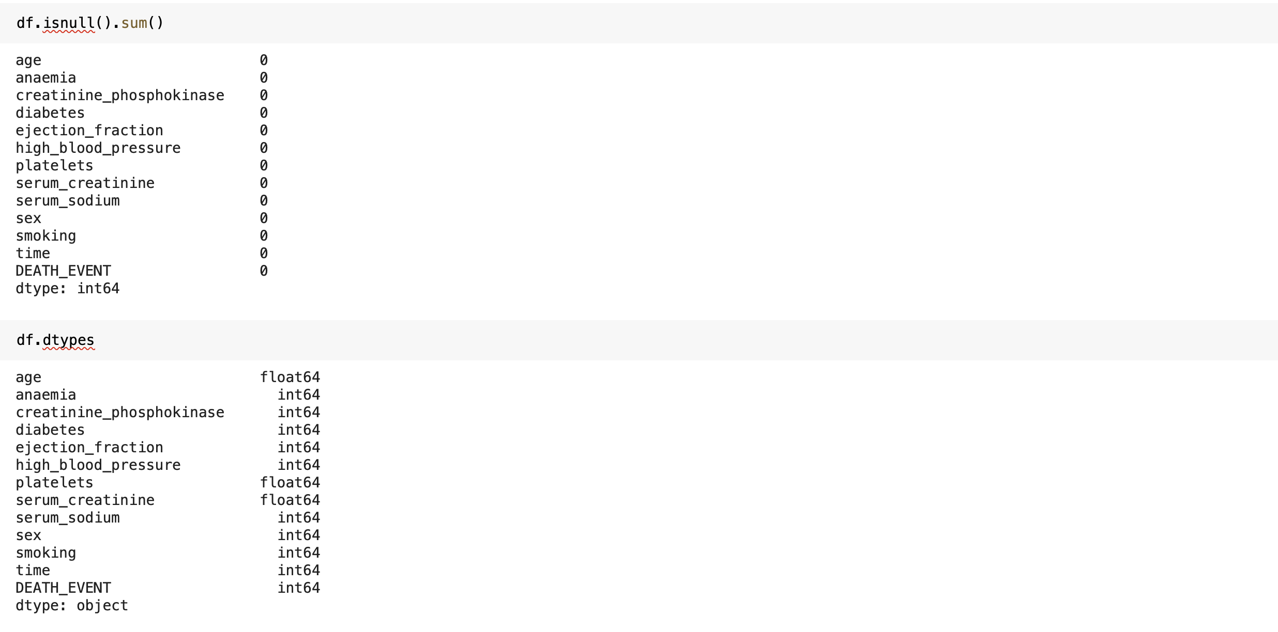

Slide 8
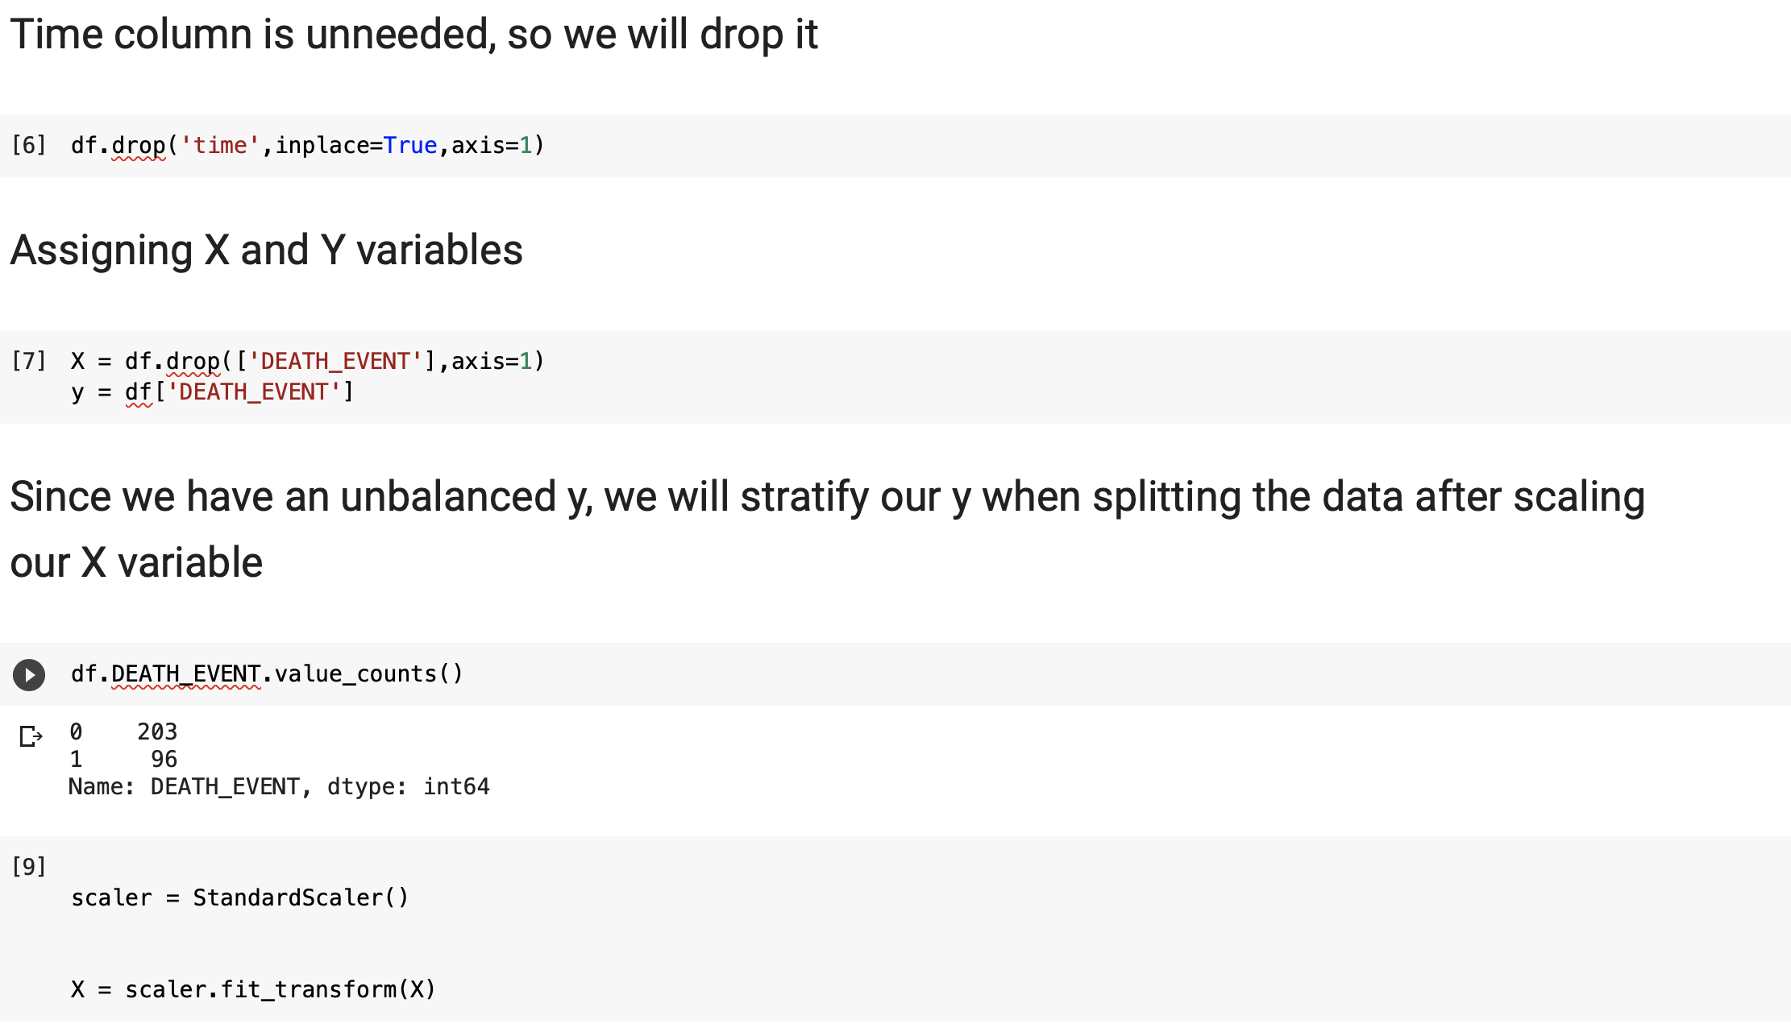

Slide 9
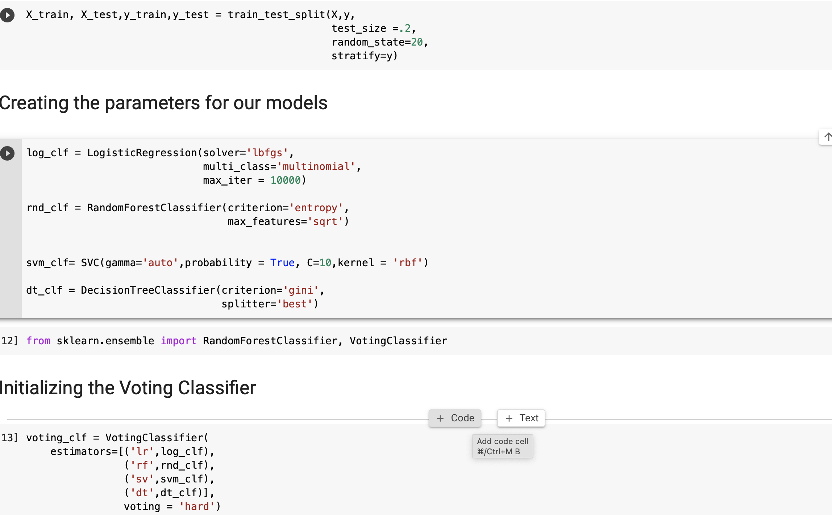

Slide 10
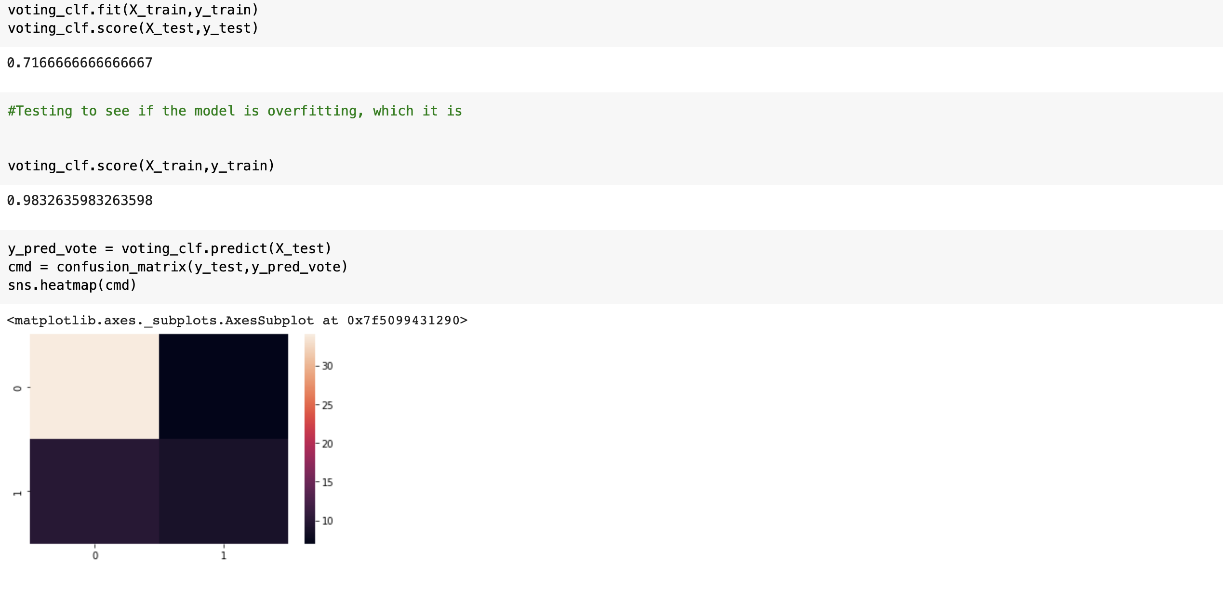

Slide 11
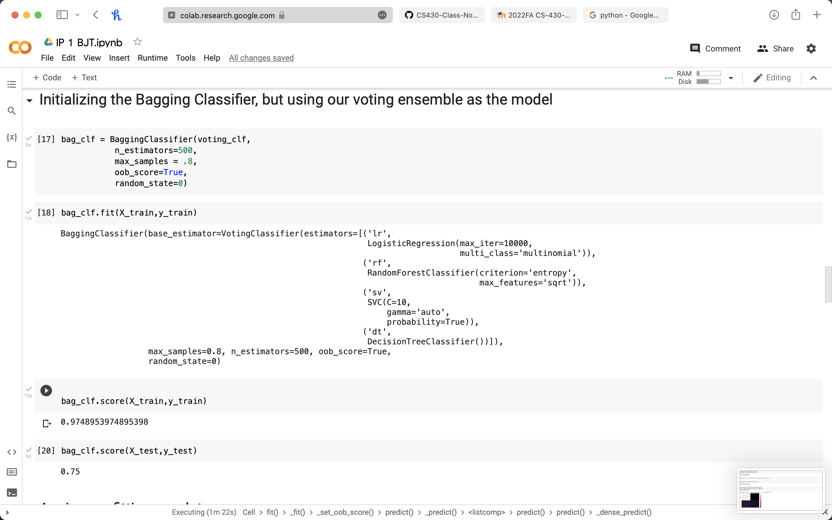

Slide 12
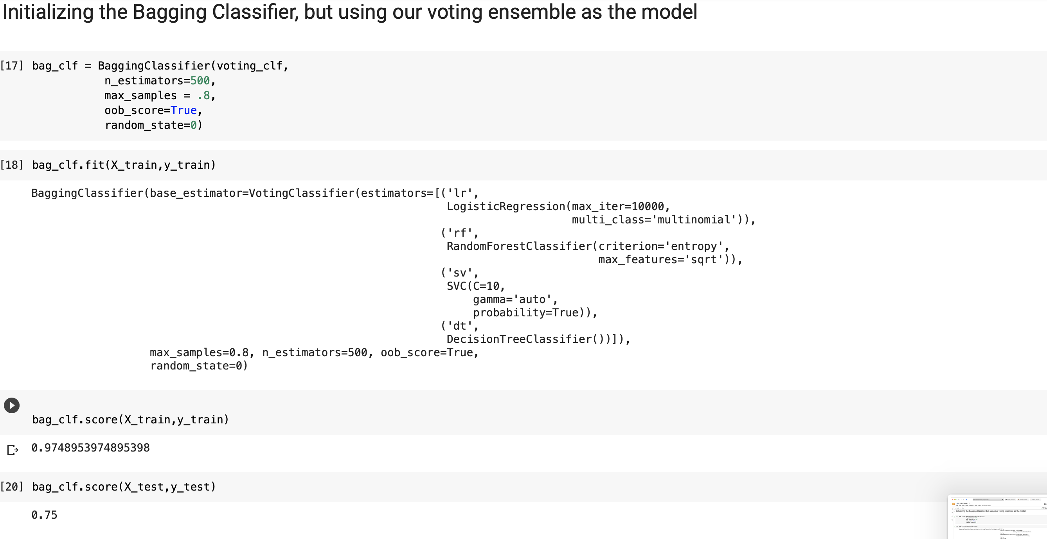

Slide 13
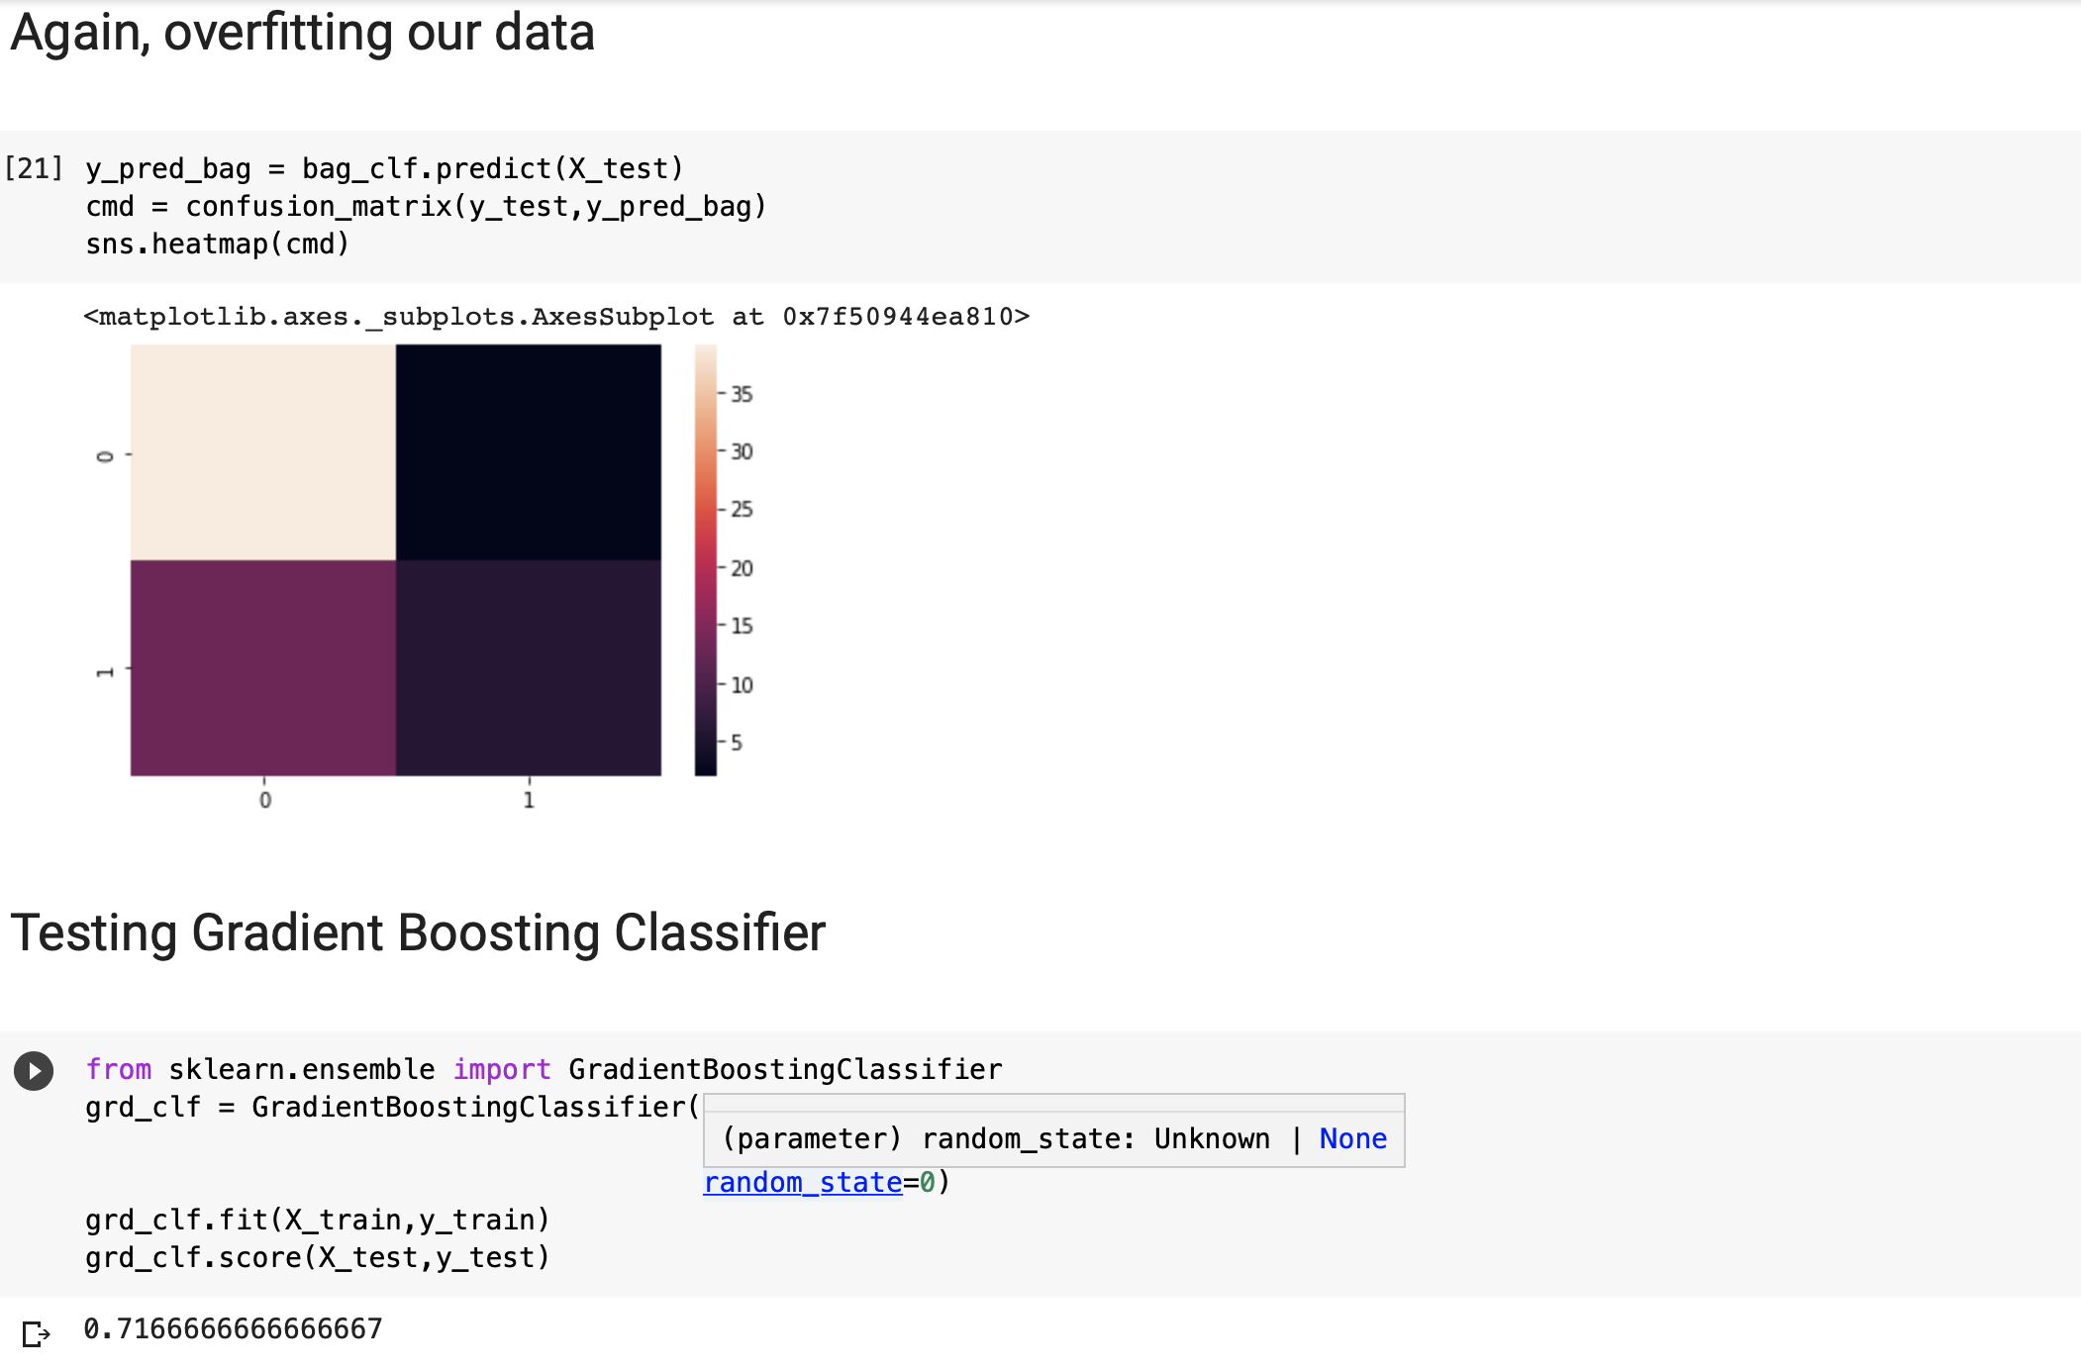

Slide 14
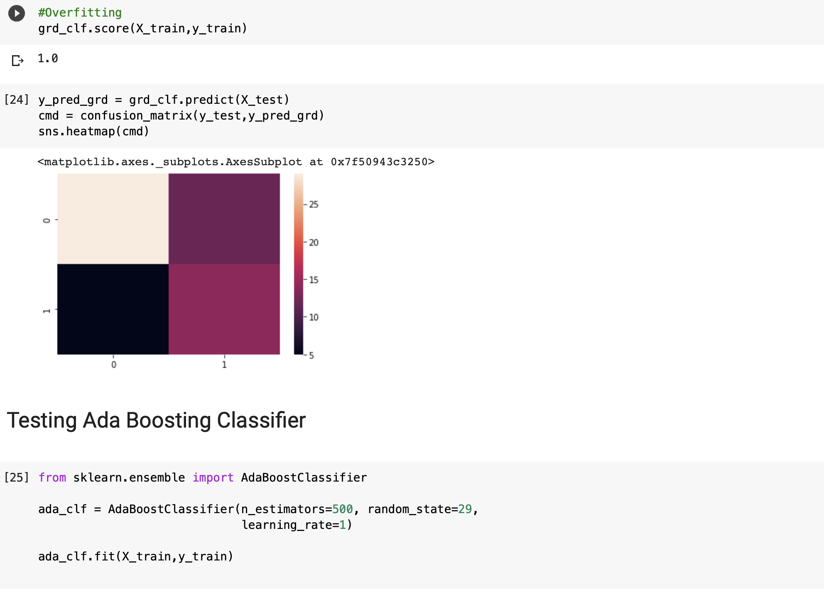

Slide 15
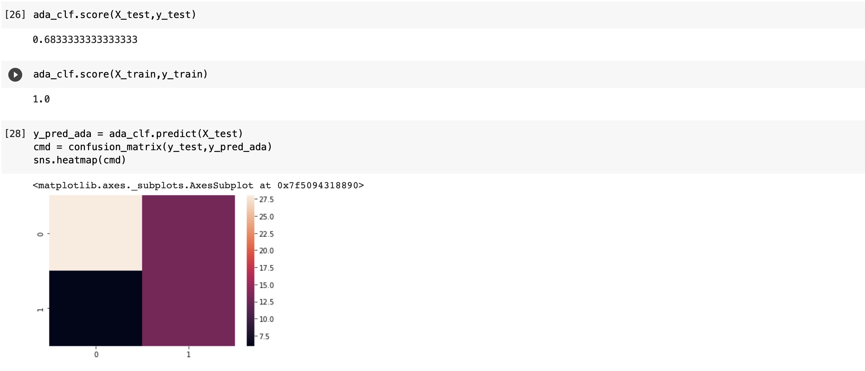

Slide 16
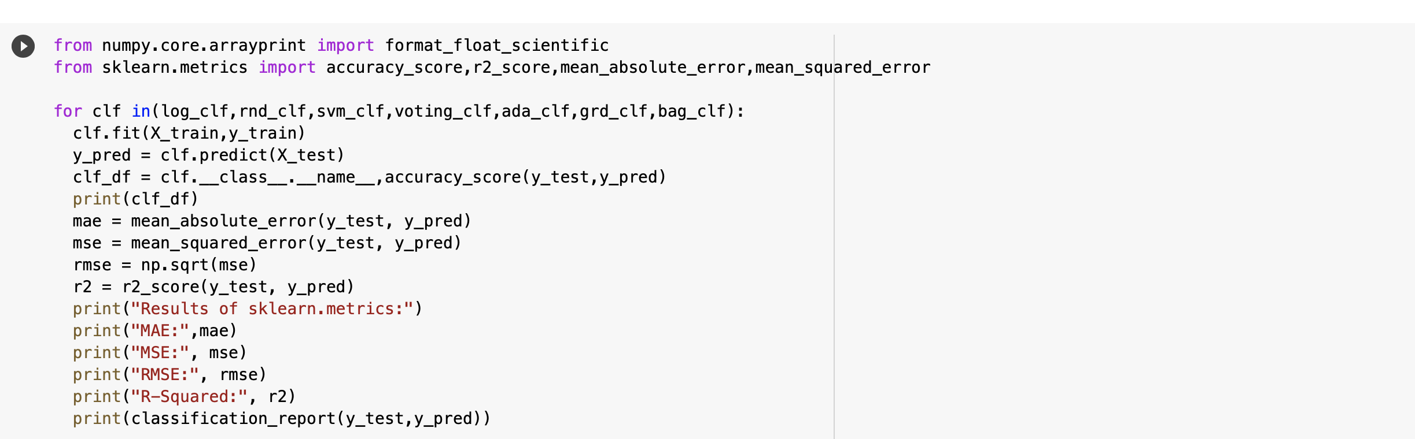

Slide 17
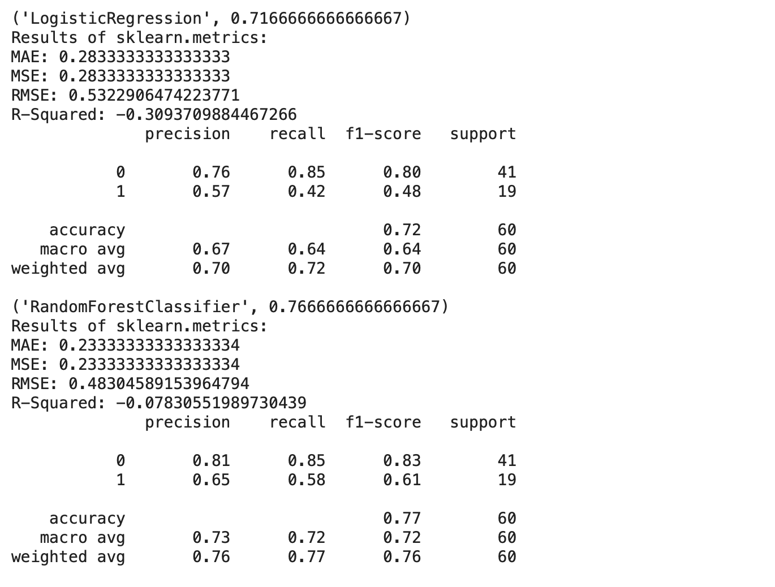

Slide 18
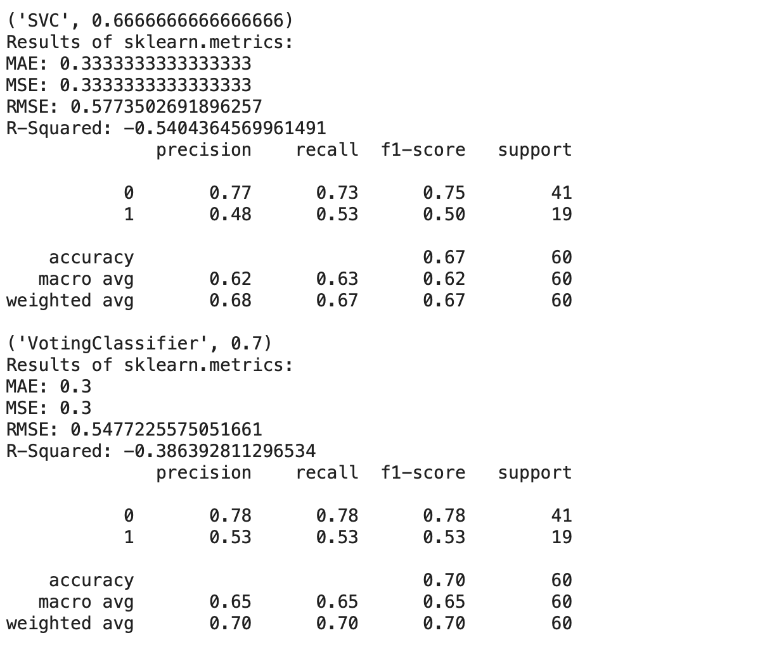

Slide 19
